Slide 1

EYFS
Little Acorns

Slide 2
Intent
In Little Acorns Class we aim to
Engage children in a lifelong love of learning. Encourage them to become independent, resourceful and resilient learners.
Create a nourishing, enabling and stimulating environment rooted in god’s love.
Have consistently high expectations of ourselves and each other.
Work in close partnership with parents and carers.
Provide a broad, balanced, and creative curriculum which extends children’s cultural capital while building upon existing knowledge, experiences and interests.
Develop deep roots for future learning and life at Hayton Primary School.

Slide 3
Implementation
In Little Acorns Class:
Children follow the EYFS curriculum, which is enhanced using Development Matters. Children are taught through a careful combination of whole class learning, adult led activities, child-initiated activities and an enabling classroom.
Our curriculum is delivered through themes which enable us to create a broad and balanced curriculum which is relevant to the children we teach. It enables children to experience a breadth of experiences and knowledge based on our unique setting and the wider world.
Our environment is an educator and as such we plan activities indoors and outdoors to enhance our continuous provision and enable children to explore, practice and develop their interests and learning. We encourage resourceful, independent learners who question and observe the world around them.
Children are given regular individual Future Focus targets which are worked on in class and at home to meet their individual learning needs.
Discrete assessments are carried out and recorded on Tapestry and shared with parents. These are used to inform next steps in learning.
We create opportunities for children to engage with the wider school community through lunch buddies, playtimes and collective worship. They also take part in the local community events such as the Leek Club competition and Open Gardens.
Our practice is regularly reviewed and assessed to maintain a high standard of teaching and learning.

Slide 4
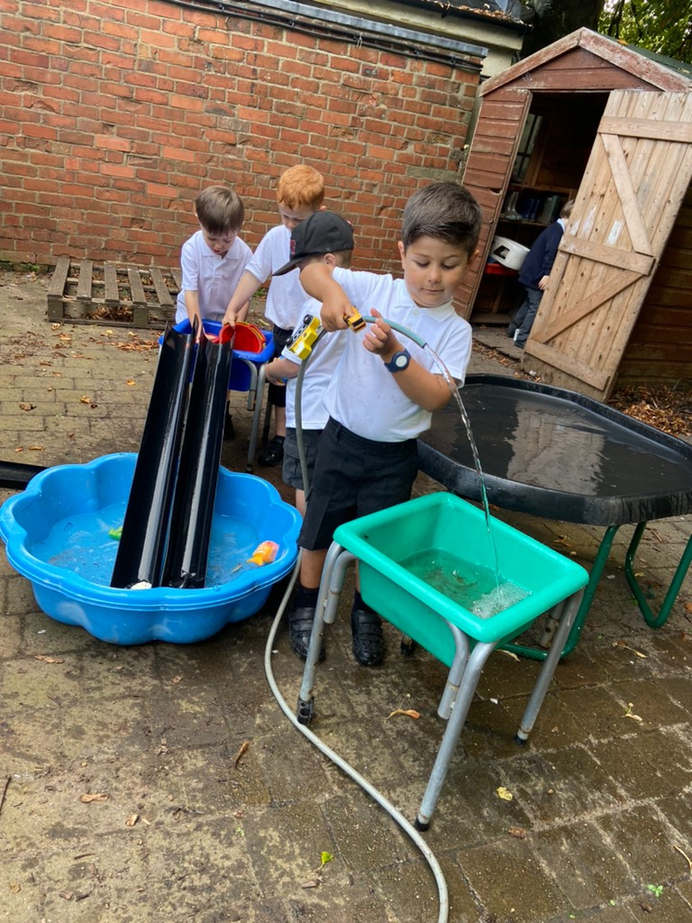
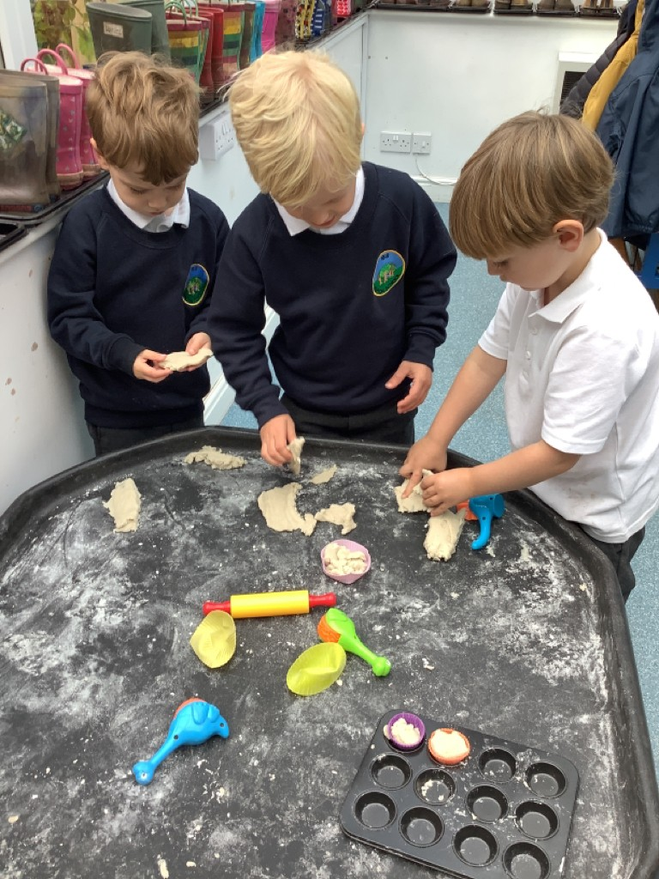
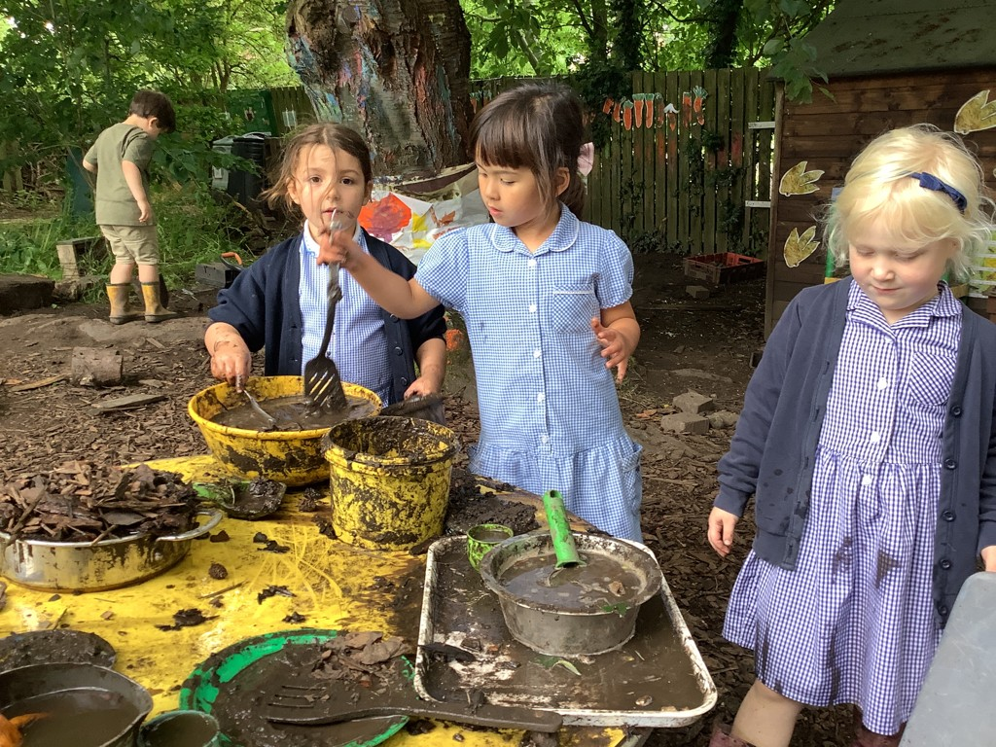
Communication and Language
We create a language rich environment and strive to use ambitious vocabulary in all that we teach. Emphasis is put-upon high-quality texts and giving children the opportunity to extend their language and communication skills in play. We have high expectations of our learners and help them to develop their listening and attention skills, enabling them to become active learners. Children are encouraged to be curious and open with each other and the staff, using vocabulary and language to talk about their experiences and the world around them.

Slide 5
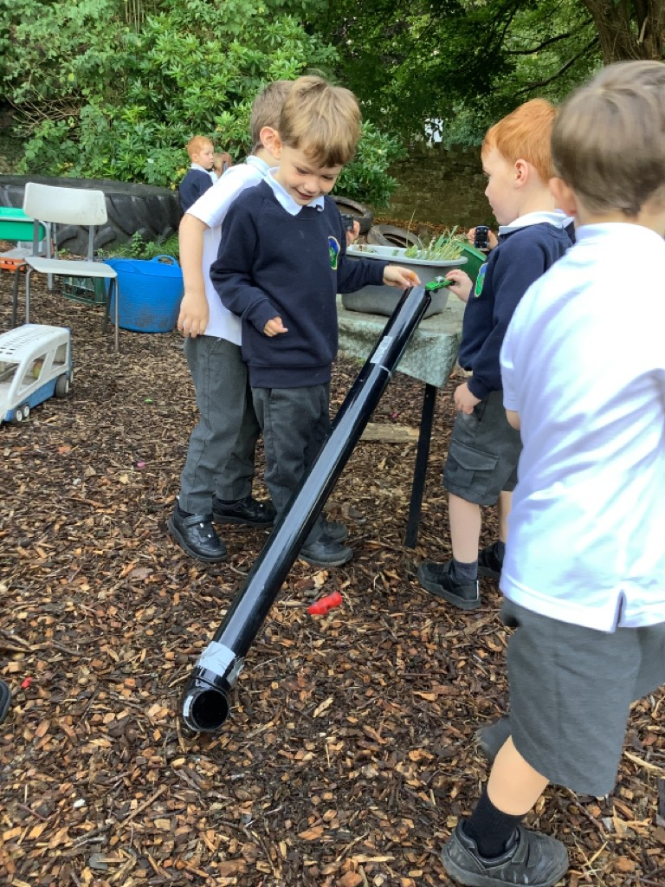
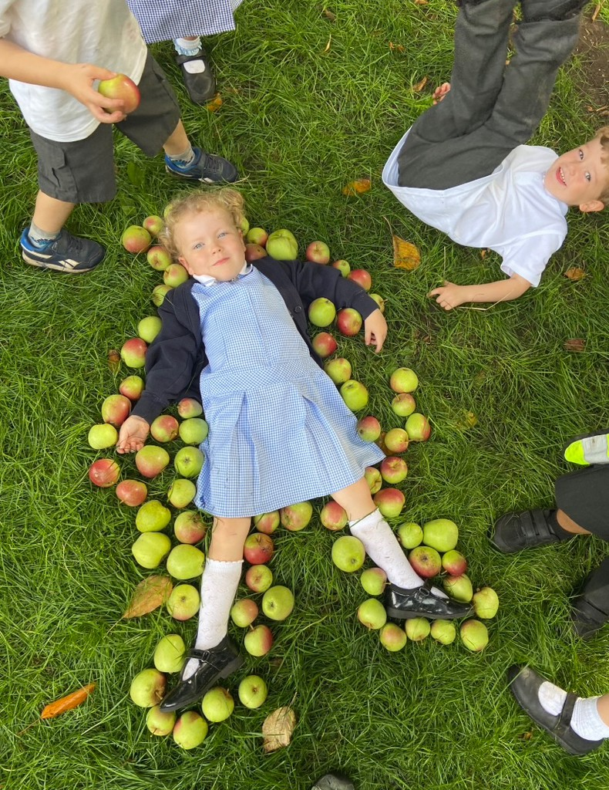
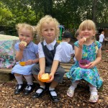
PSED Development
We understand the importance of personal, social and emotional development through a child’s life and want our children to feel safe, secure and happy at school and home. We offer a robust curriculum, with lessons focusing on managing emotions, setting simple targets, learning to share and take turns, managing personal needs and developing healthy eating habits. We have high expectations of ourselves and each other and model these at all times while supporting children to cooperate, make friends and resolve conflicts as and when they arise.

Slide 6
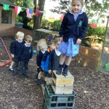
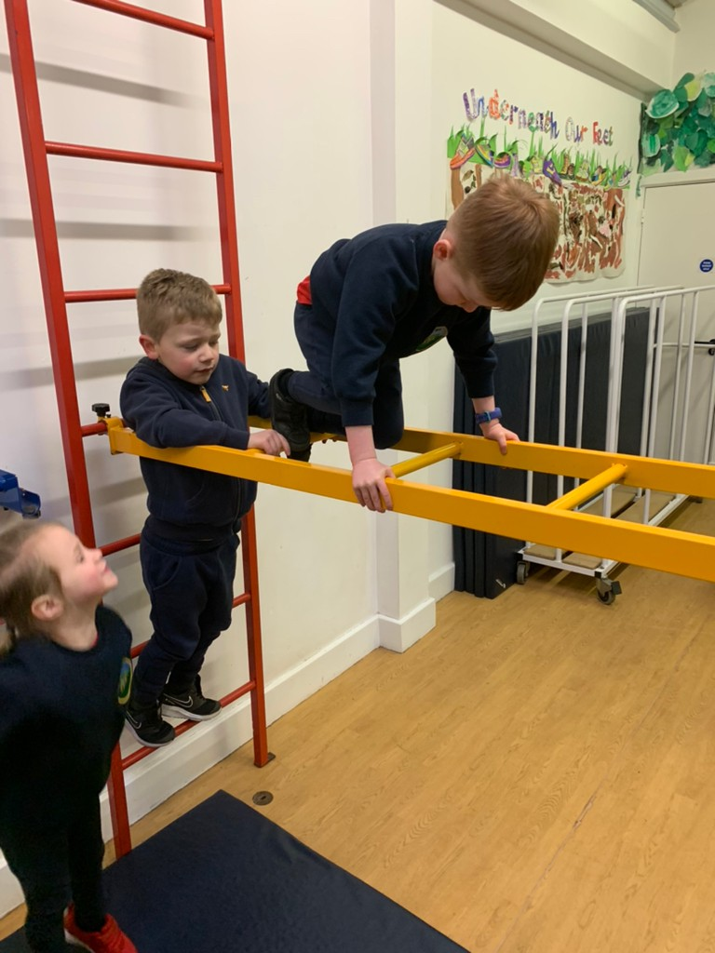
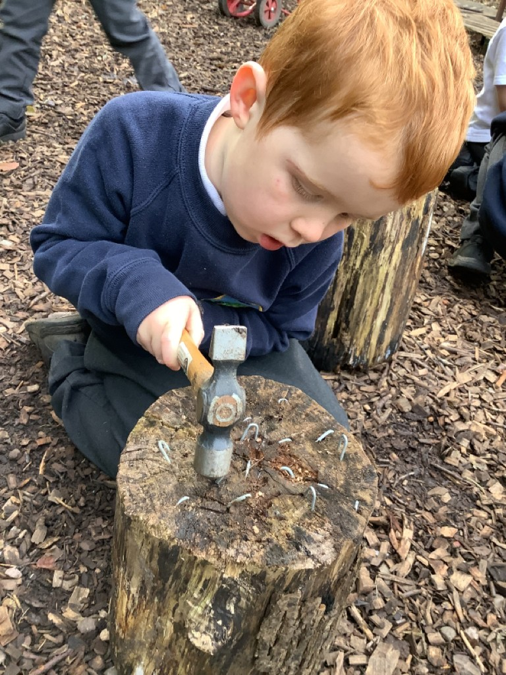
Physical Development
Children in Little Acorns class have daily opportunities both indoor and outdoor to work on their gross and fine motor skills. We offer a challenging environment which enables children to take risks with support and develop their strength, agility and coordination. Children develop good pencil control through opportunities in continuous provision such as drawing, cutting, building, threading, using tools and malleable materials. Children take part in weekly PE lessons with a specialist teacher to extend their skills, movement, cooperation and understanding of keeping healthy.

Slide 7
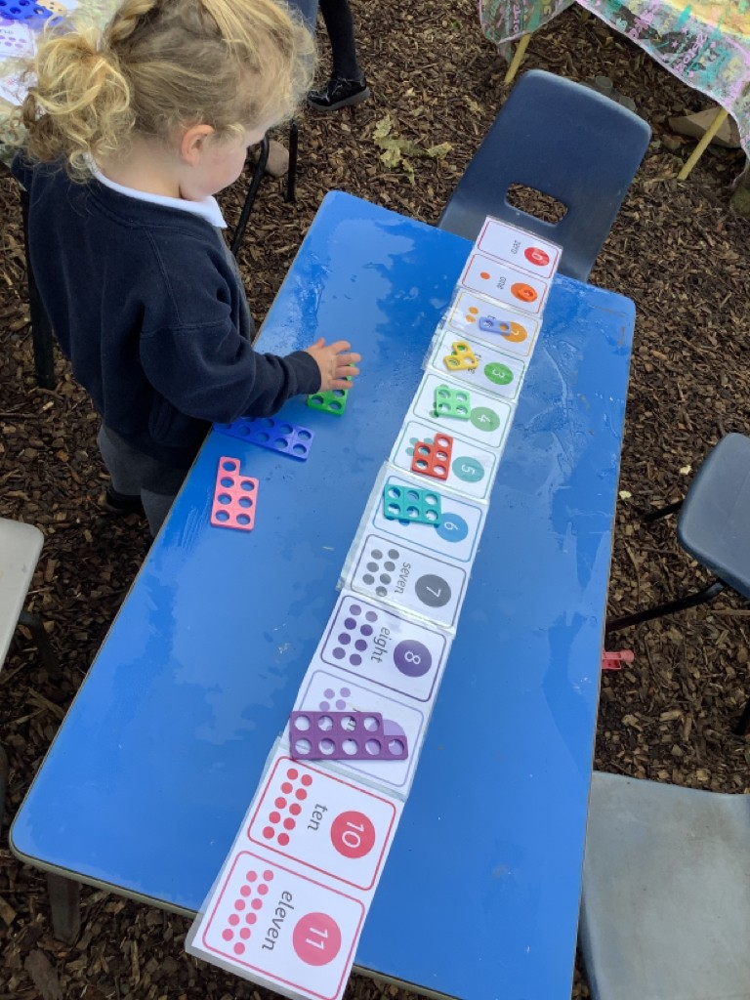
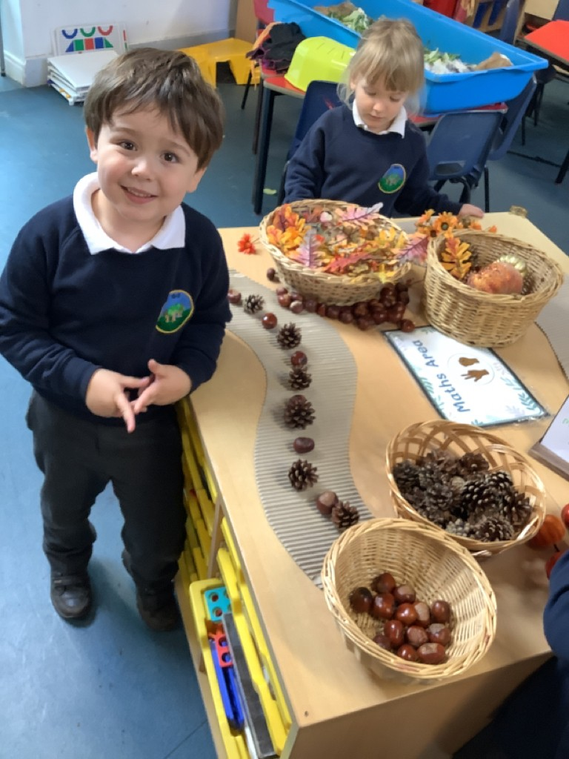
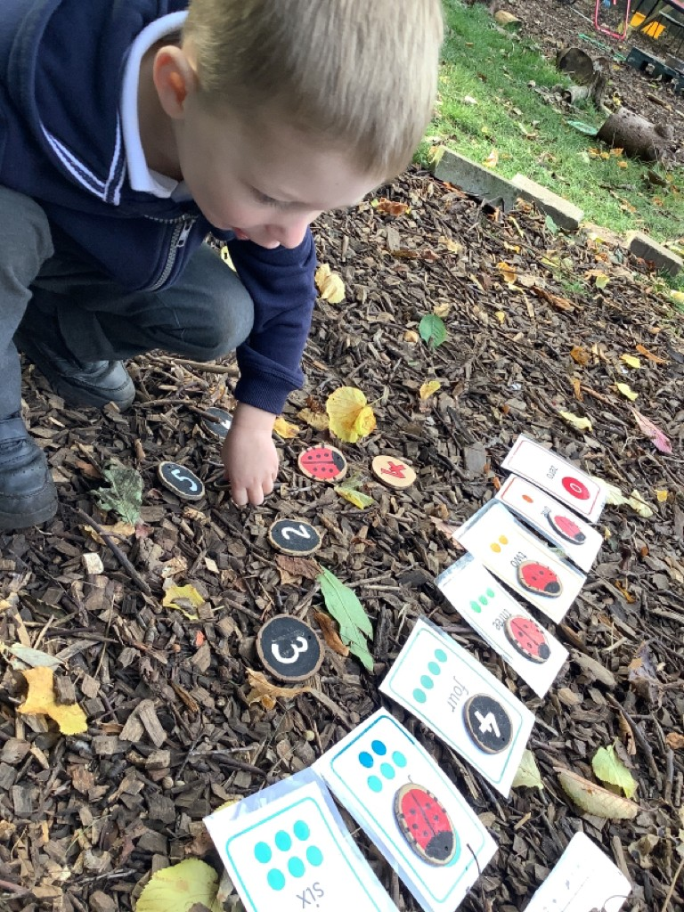
Mathematics
Strong knowledge of number begins in EYFS. Children are taught a deep understanding of numbers to 10 and how to carefully count and understand patterns and relationships between these numbers. At Hayton Primary School we follow White Rose Maths with enhancements from NCETM maths mastery. Children are given lots of practical opportunities and manipulatives to explore and deepen their understanding of Mathematical concepts. maths enhancements in continuous provision allow children to explore and consolidate the taught concepts.

Slide 8
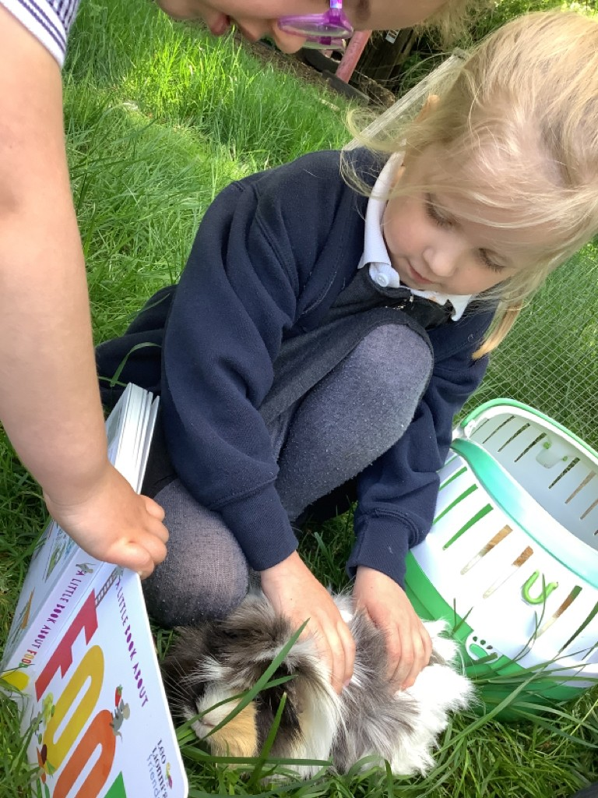

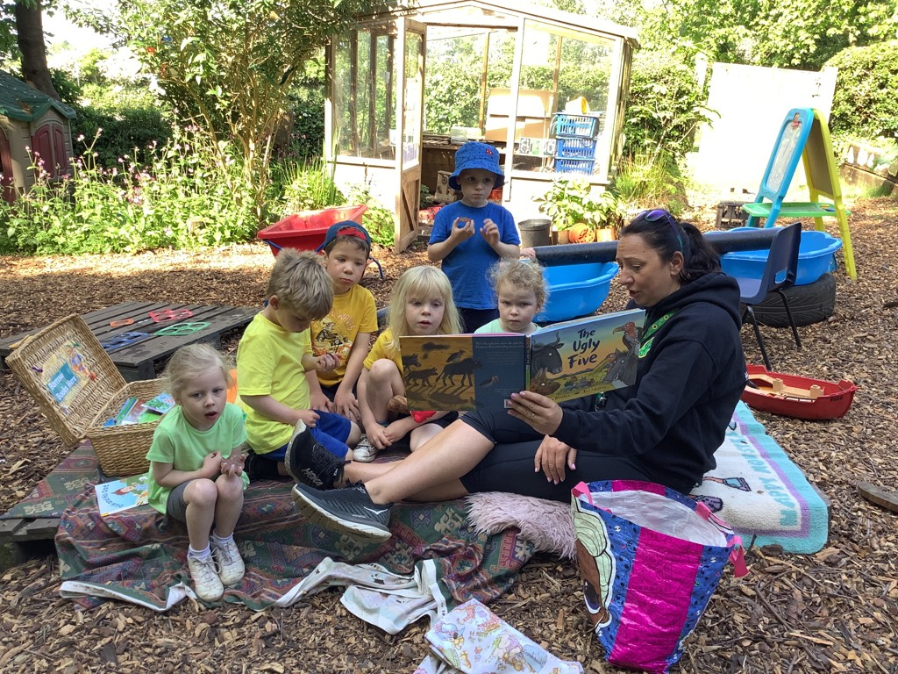
Literacy- Early Reading
In Little Acorns class we love to read and encouraging children into a life-long love of reading is at the heart of our teaching and learning. In Nursery children are taught to discriminate sounds around them and play with and enjoy rhymes and syllables. When children are ready, they begin learning some Phase 2 letter sounds through our chosen Phonics scheme Essential Letters and Sounds. This is a systematic, synthetic phonics programme offering a consistent whole school approach to using phonics for reading, spelling and writing. This scheme is structured, progressive and matched to fully decodable reading books. We listen to children read in class often and encourage parents and children to read regularly with our whole school Strive for 5 challenge.

Slide 9
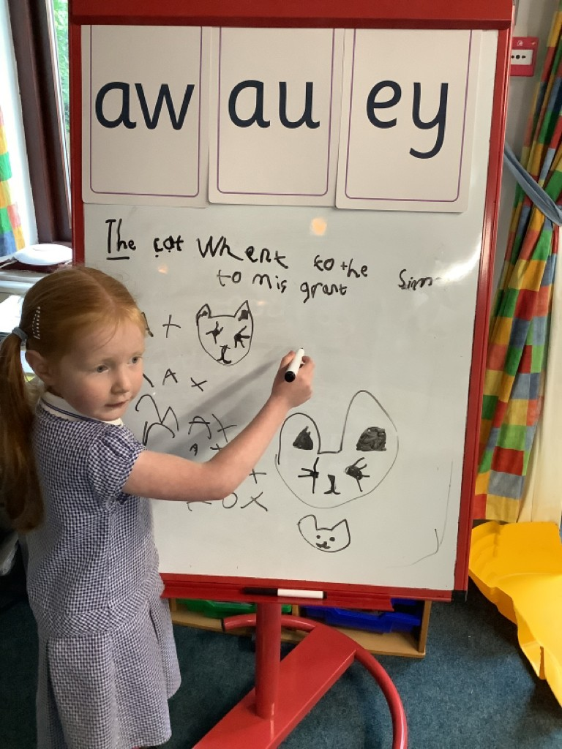
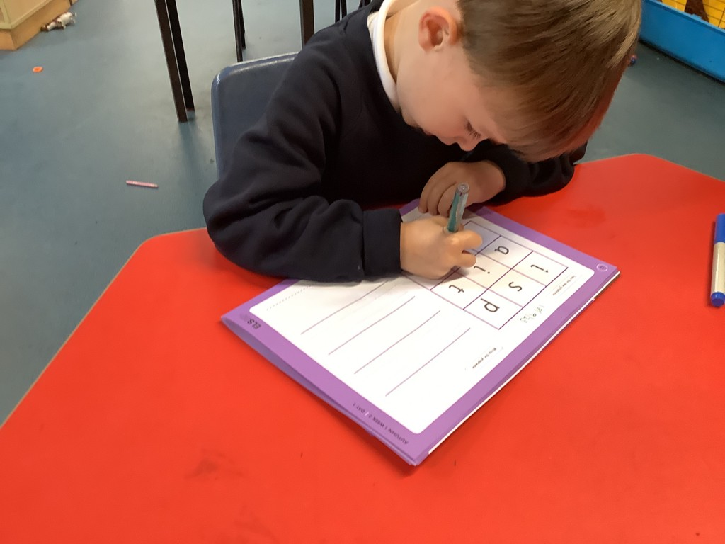
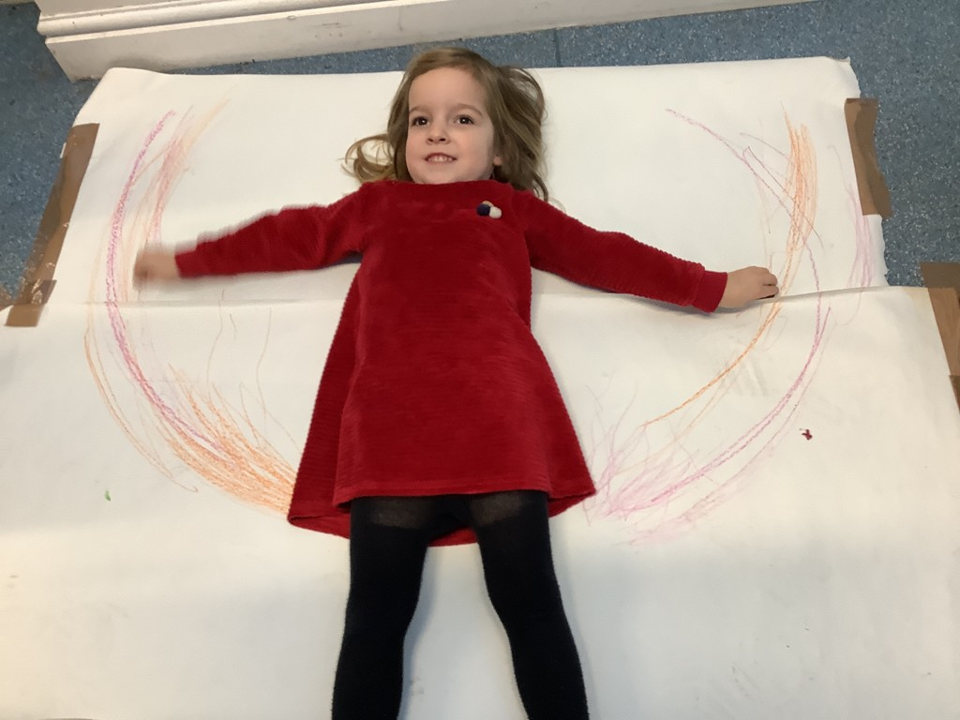
Literacy- Early Writing
Through Essential Letters and Sounds phonics, children are taught to form recognisble letters with correct formation from the beginning. Children are taught to spell words through segmenting the sounds, then writing simple phrases and sentences. From nursery children begin to develop strong fine motor skills needed for handwriting. They are encouraged to mark make in their play and given lots of opportunities to practice and refine their writing skills. Within the continuous provision on offer, there are always a range of fine motor skill activities aimed at developing and strengthening their pincer grip. We use Literacy Counts as a basis for Literacy lessons, allowing children to engage with high quality texts while developing strong early writing skills and fostering a love of reading.

Slide 10
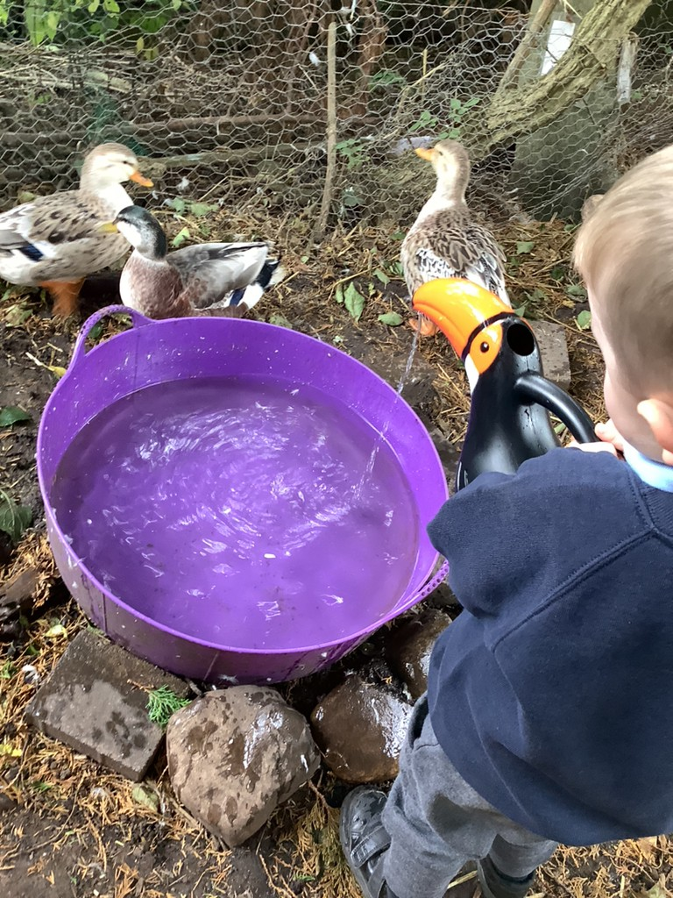
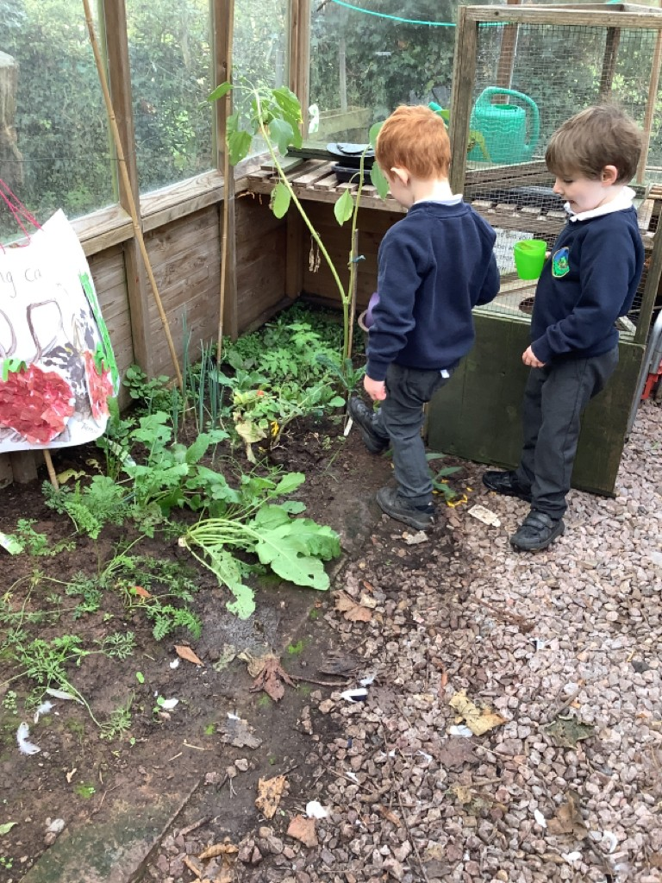
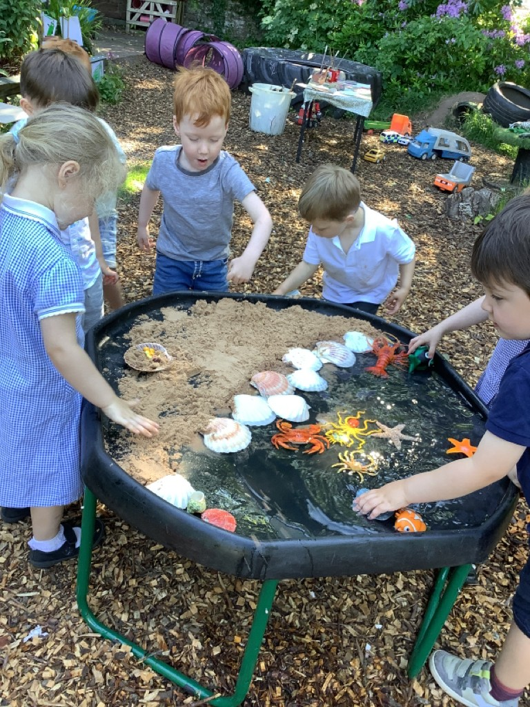
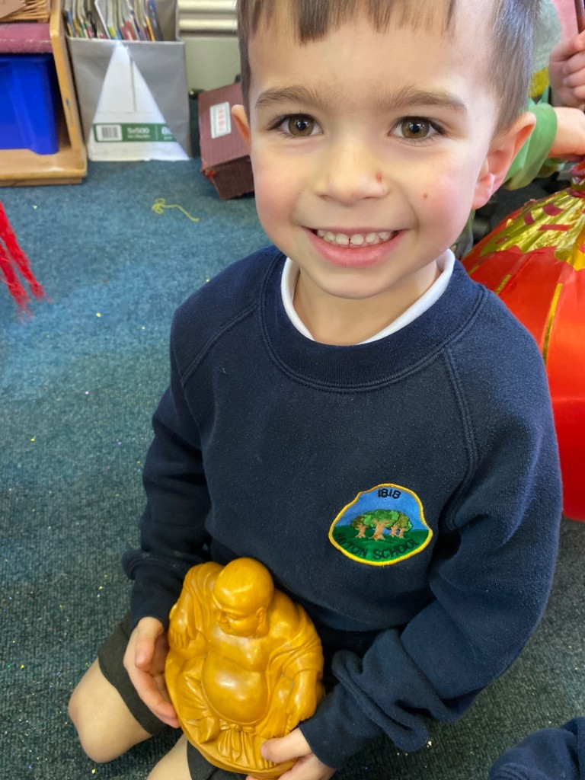
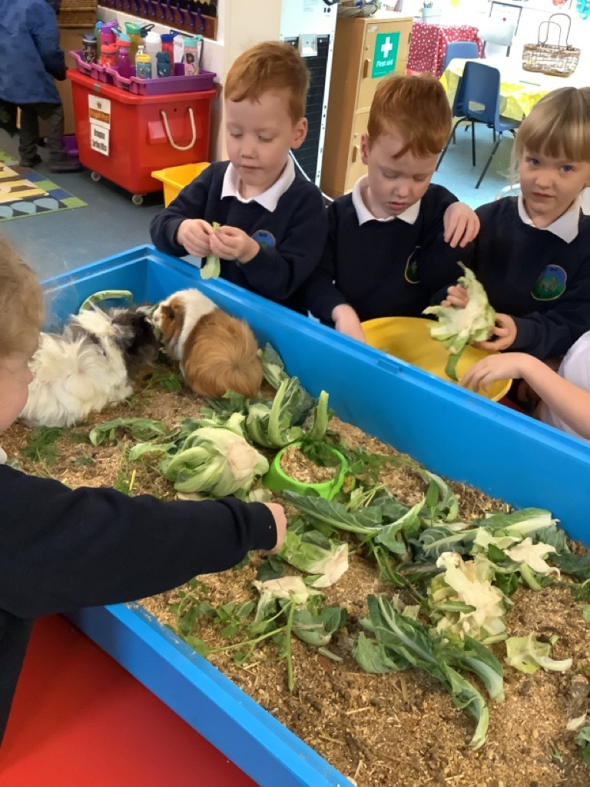
Understanding of the World
Children in Little Acorns class develop a strong understanding of the natural world around them, the seasons and life cycles. We have a unique environment which enables children to plant, grow and cook their own food, see how the seasons change all around them and take part in daily animal care routines. To develop children’s understanding of people, places and communities we work locally with the church and routinely plan trips and visitors who enrich and extend our learning. Staff share experiences, artifacts and books to help broaden children’s horizons while cultural differences and religions are highlighted and celebrated through our RE curriculum.

Slide 11
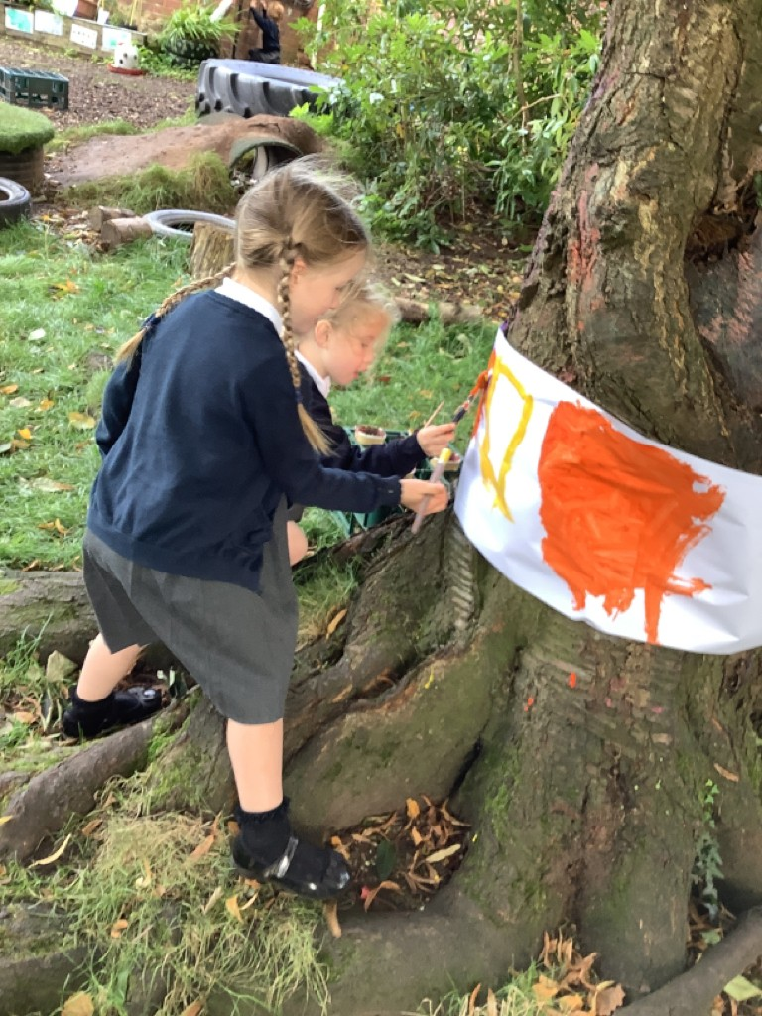
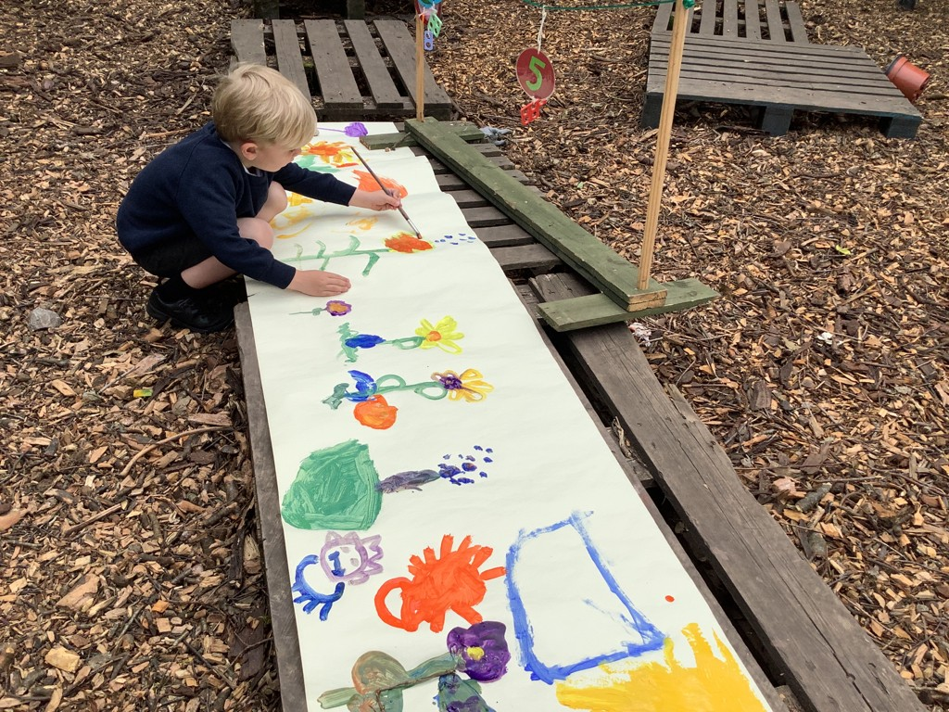
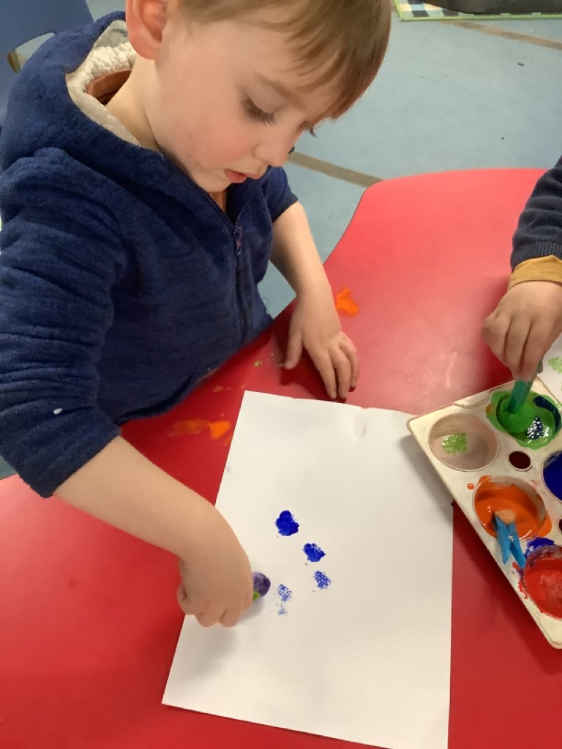
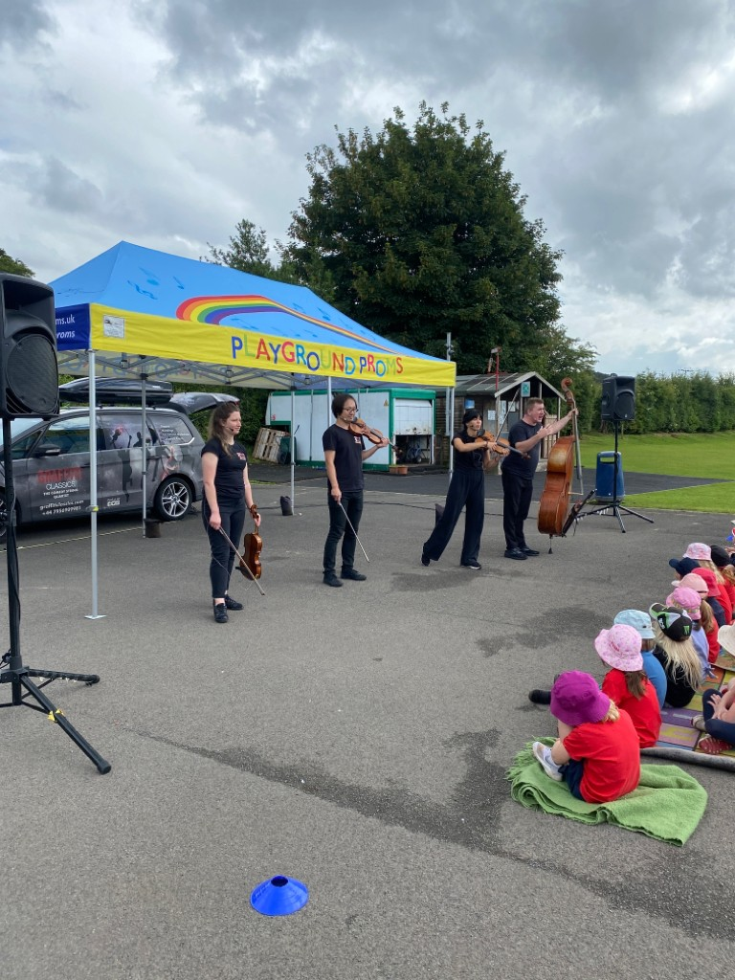
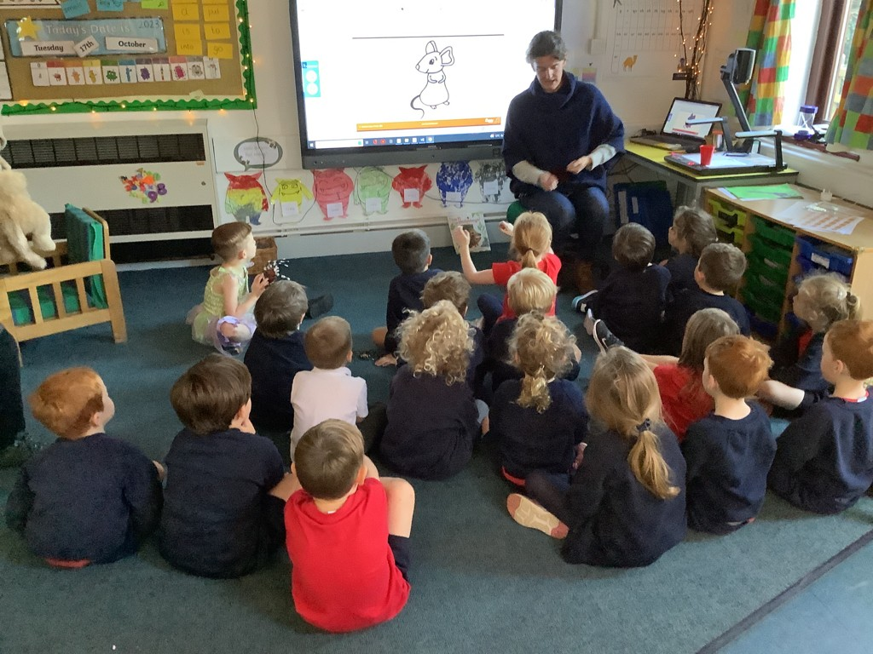
Expressive Arts and Design
Pupils in Little Acorns class are given daily opportunities to engage in, explore and play with a range of creative media and materials. Through continuous provision and planned sequences of creative lessons, children learn to appreciate Art, Design, movement and Music. We expose children to artists work and encourage them to think and express themselves creatively in their work and play. Children are encouraged to explore different media and make choices about the work they create, talking about the choices they have made using new and varied vocabulary.

Slide 12
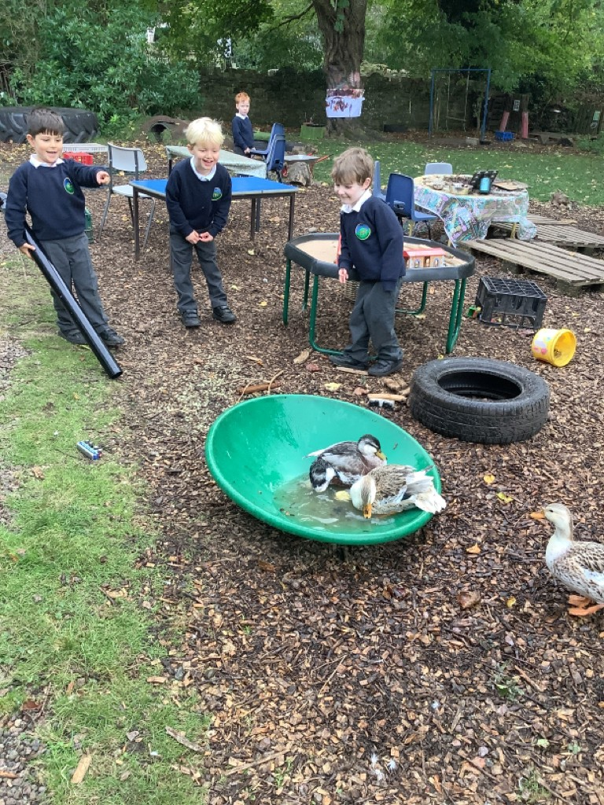
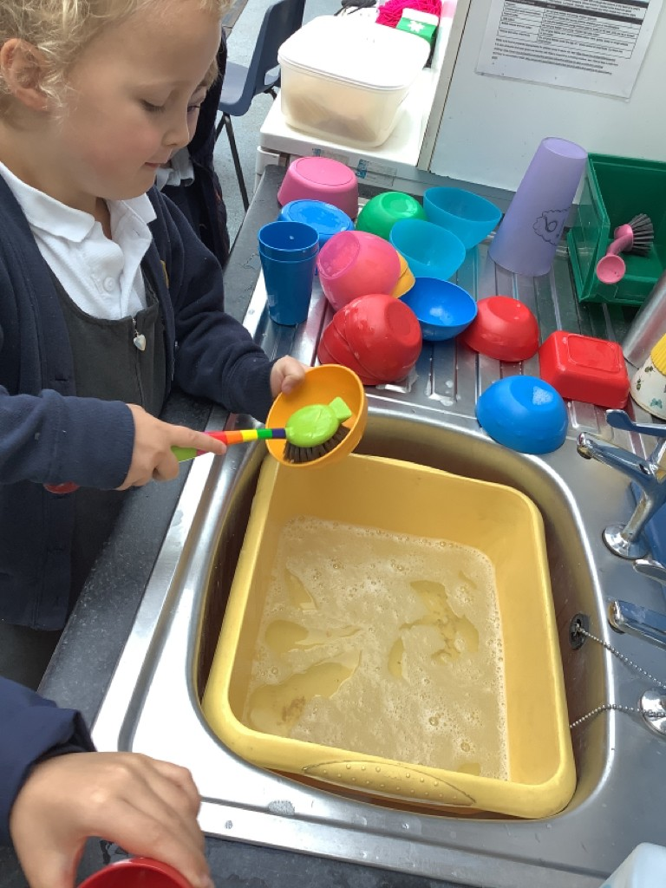
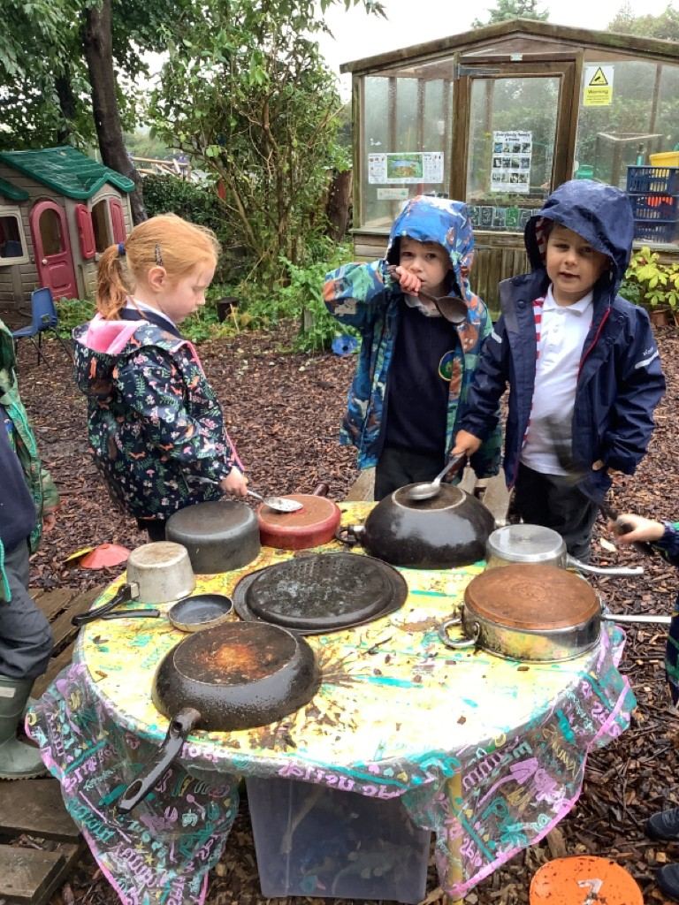
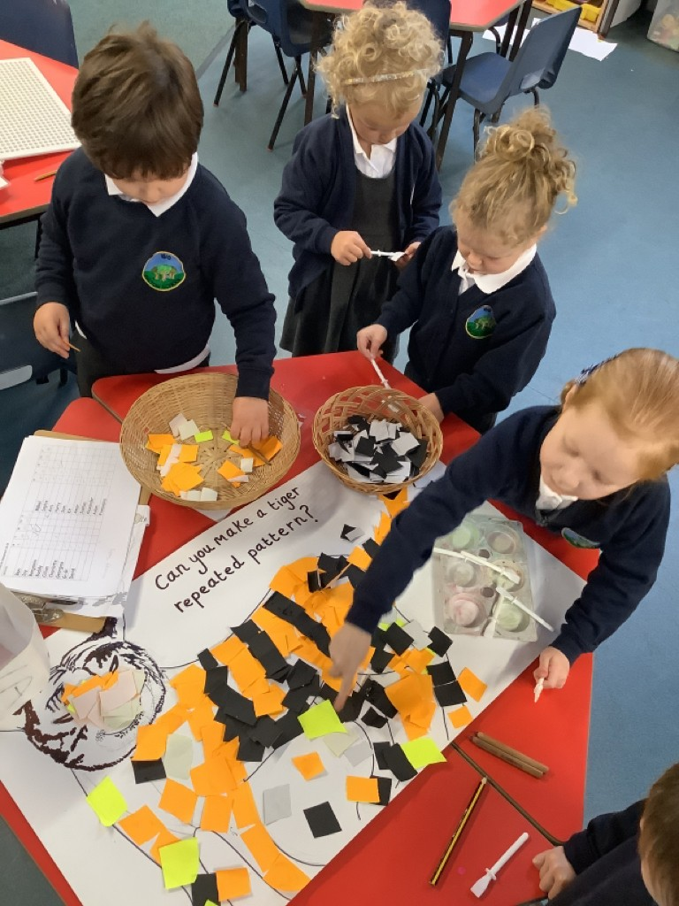
Continuous Provision
We are very lucky to offer a wonderful, big and varied environment for the pupils in Little Acorns Class. Children have continuous access to our ‘Secret Garden’ which is home to trees, plants, a greenhouse, a cozy cabin and 3 free range ducks. We carefully plan our provision both indoor and outdoor to allow children to develop skills, consolidate learning, expand thinking and extend speech and vocabulary. Through a combination of child-initiated play, planned provision and ‘in the moment’ planning, we can respond to children’s interests and extend their learning.

Slide 13
Vocabulary and Oracy
Inclusion
Our curriculum is planned to be accessible for all children and offers opportunities for deeper thinking and challenge where appropriate. We get to know the children very well and understand that they all have different starting points. Children make progress from this point which is carefully monitored throughout their time in Little Acorns class.
To ensure that all children make good progress we have different strategies in place which happen daily such as extra scaffolding, targeted interventions, group interventions and additional adult support such as NELI or ELS phonic interventions. Each child has an individual ‘Future Focus’ target to work on which enables adults to focus on specific needs when extending play or working with a child.
Vocabulary is very important in our curriculum and is shared with children during lessons. At every opportunity we expose children to new words and teach them how to use them. We learn poems, retell books and encourage children to question and give opinions. We use stem sentences and ambitious vocabulary in Maths lessons, providing opportunities for children to use these in context.

Slide 14
Impact
Baseline assessments are carried out during the first few weeks at school and with input from parents to identify individual starting points for learning. The DFE Baseline is completed.
Practitioners use their knowledge of children and professional judgement alongside observations from staff members and parents on Tapestry, books and assessment meetings to identify progress half termly.
Children who are not ‘On Track’ are identified quickly and interventions are put into place immediately. They are then regularly reviewed by practitioners. Teaching and learning are revisited and reworked in light of assessments.
Children are given individual ‘Future Focus’ targets which are shared with parents and carers. Staff and carers regularly support children in reaching these targets and they are assessed and updated at least half termly.
At the end of the Reception year, children are assessed against the Early Learning Goals and the EYFSP is completed. Children will be assessed as Emerging or Expected.
Children have a phased transition to Year 1over a number of weeks at the end of their Reception year which includes visiting their teacher and classroom, their new teacher coming in to read stories and play alongside them. Impact is seen through a successful transition into the wider school community and curriculum.

