Slide 1
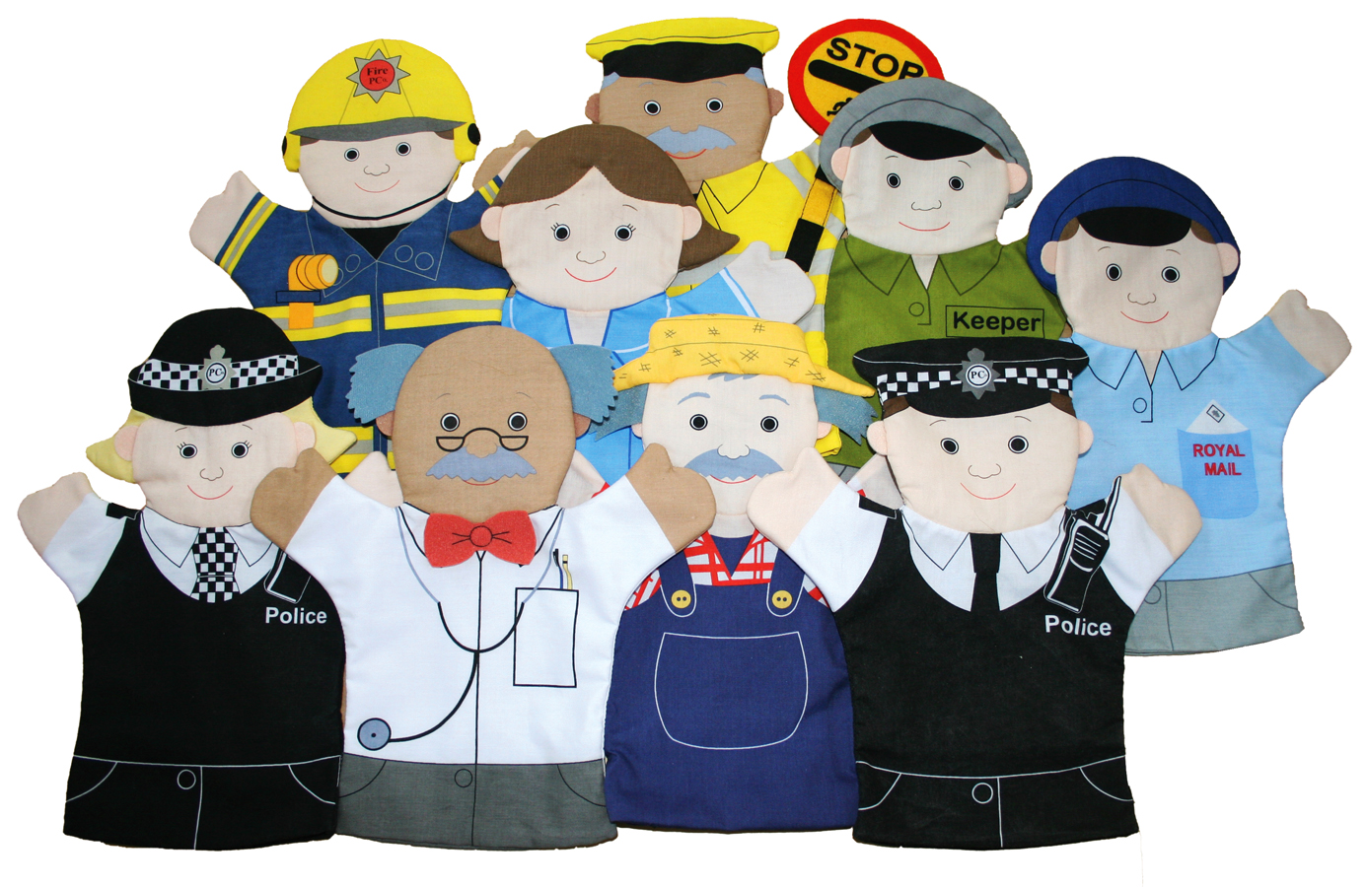

Books we will be reading:
Core Texts
My Mum is a Superhero
Franklin Goes to the Hospital
Charlie the Firefighter
Mog and the VET
Here come the Superheroes
George Saves the World by Lunchtime
In our other curriculum areas we will be learning
Understanding of the World | People Who Help us in school and home. Who helps us? Doctors & Nurses past and present- who is Florence Nightingale? firefighters past and present Vets- how do they help? Police- how do they help us? Helping in the community- special groups e.g. churches and clubs
Expressive Art and Design- Scuplture | Making a thank you card for parents and carers, using tissue paper to create flowers. Printing with emergency car wheels Painting pictures of people who help us Recycling- making junk models, reuse, reduce and recycle.
PHSE- Building relationships: Special relationships | My family Special people Sharing I am unique My interests Similarities and differences
RE | Being special; where do we belong? .
Communication & Language | Nursery Be able to express a point of view and to debate when they disagree with an adult or a friend, using words as well as actions Use longer sentences of four to six words Reception Articulate their ideas and thoughts in well-formed sentences. Connect one idea or action to another using a range of connectives. Engage in non-fiction books. Listen to and talk about selected non-fiction to develop a deep familiarity with new knowledge and vocabulary.
‘Little Acorns’ Learning Overview Spring Term 1 2026
People Who Help Us
In our writing we will be learning and embedding:
Correct letter formation for all letters of the alphabet.
To write more of the Harder to Read words.
To develop use of capital letters and full stops.
To hold our pencil correctly.
To write some capital letters correctly.
In Maths we will be learning and embedding:
RECEPTION
White Rose Maths Topics
Alive In 5​
Mass and Capacity
Growing 6,7,8​
Length, Height and time​
NURSERY
Subitising 2 Show me 1, 2, 3
Counting 3 Move and label 1, 2, 3
Shape, space and measure 3 Explore position and routes
Pattern 3 Explore own first patterns
In our phonics we will be learning:
RECEPTION
/oo/ (book)​
ar/ /ur/ /oo/ (food) /or/ ​
ow/ /oi/ /ear/ /air/ ​
ure/ /er/ /ow ​
Ball, tall​, They, all, are​, When, what ​
NURSERY-
s – snake
a – ant
t – teacher
p – parrot
i– inventor
n – nest
Things to remember this term:
PE on Wednesdays and Thursday alternating. Reception need PE kit left in school. No PE kit for Nursery.
Please note: this learning is not set in stone as we like to be flexible to children’s interests and needs as well as current events – thank you

