Slide 1

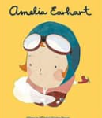
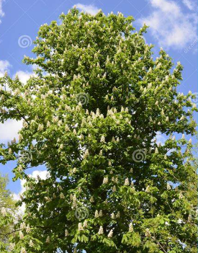
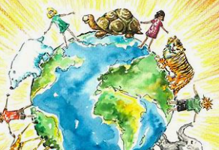



Books we will be reading:
‘Grandad's island’ by Benji Davies
‘The True Story of the 3 Little Pigs’ by Jon Scieszka
'The Wolf's Story' by Toby Forward
In our other curriculum areas we will be learning?
History | How did we learn to fly?
Geography | Why is our world wonderful?
Science | Materials: Uses of everyday materials | Animals: Life cycles and health
Art | Sculpture and 3D: Clay houses
Design and Technology | Structures: Grandad’s Deckchair
Computing Science | Computer systems and networks Word Processing | Programming: Scratch Junior
RE | Jesus: Why did Jews welcome everyone? | Easter: How do the symbols help us to understand the Easter story?
PHSE | Safety and the Changing Body | Citizenship
Music | Folk Songs | Dynamics, timbre, tempo and motifs (Theme: Space)
PE | Ball Skills | Gymnastics
Chestnut Class Learning Overview Spring Term 2025
We will be writing:
Return narrative
Information Text
In our Maths we will be learning and embedding:
Shape
2-D shapes
3-D shapes
Lines of symmetry
Money
. Counting money – pounds and pence
Compare amounts of money
Find change
Multiplication and Division
Equal Groups and Arrays
2, 5 and 10 timetables
Divide by 2, 5 and 10
We will also have tasks set on ‘Mathletics’ and ‘TTRS’
In our writing we will be learning and embedding:
Correct choice and consistent use of past and present tense throughout writing
Expanded noun phrases for description
Subordination (using when, if, that, because)
Co-ordination (or, and, but)
Question, exclamation and statement
Formation of nouns using suffixes e.g. –ness, –er
Formation of adjectives using suffixes e.g. –ful, –less
Use of the suffix –ly to turn adjectives into adverbs
Inverted commas; full stop, capital letter, exclamation mark, question mark
Our spellings will come home each week:
/u/ spelled ‘o’
Homophones
/or/ spelled ‘a’
Compound Words
Apostrophes for contraction and possession
Common Words
Suffixes -ing, -ed, -er, -y, -est, -es
Things to remember this term:
PE – Every Tuesday and Wednesday
Zozo drumming - 17th Jan
Outdoor Learning – 24th Jan, 7th Feb,
7th March and 28th March
Log ins you will need for online learning and homework:
Mathletics
Times Tables Rock Stars
Please note: this learning is not set in stone as we like to be flexible to children’s interests and needs as well as current events – thank you

