Slide 1

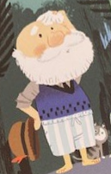

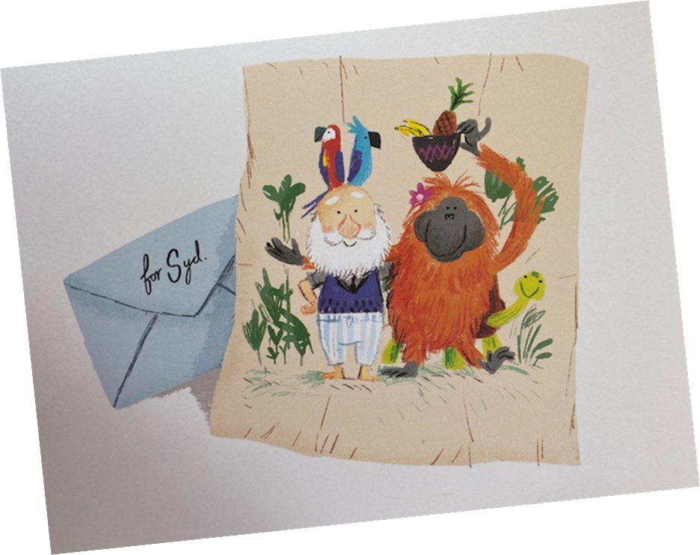

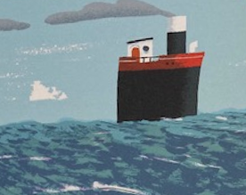


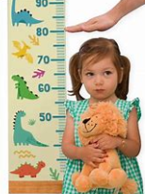
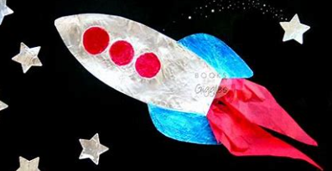
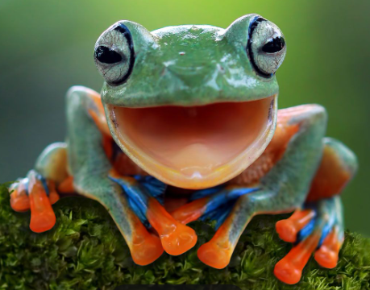
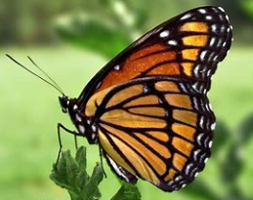
Chestnut ‘Reach for the Stars’ Homework – Spring Term 2025
Science: Materials: Design a waterproof coat for ‘Grandad’. What would you make it out of? How would you make sure ‘Grandad’ kept dry during tropical downpours? | English: Read another book written by Benji Davies. | Geography: Where is your most amazing place in the World? Can you produce a pamphlet to persuade someone to visit? | History:
English: Letter Writing Write a letter that might be inside the envelope that Syd receives at the end of the story | ‘Reach for the Stars’ Homework challenges! Over the term, we would like you to choose a different challenge each fortnight. There are lots to choose from – over the term you only need to complete FIVE! Hand-in dates: Practice quick fire 24th Jan maths questions on 7th Feb Topmarks Hit the Button. It’s free and lots of fun. 28th Feb 14th March 28th March |  | Science: Materials: Design a ship for Grandad. Can you design a new ship for Grandad using different materials? Test it to see if it will float. How much cargo will it hold without sinking?
Geography: The UK Name and locate the four countries and capital cities of the UK on a map of the UK. Where do we live? Where have you visited?
Maths: Height Measure the height of every member of your family in metres and centimetres. Can you order from the shortest to the tallest? You can even include your pets! | Art: Create a picture or collage of a form of transport such as a rocket or ship. | Science: Animals – Lifecycles: Make a poster about the lifecycle of a frog or a butterfly | Art and Design: Draw a picture of Grandad or Syd with Benji Davies Benji Davies illustrates a character from Grandad's Island

