Slide 1
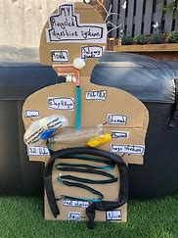
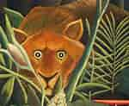
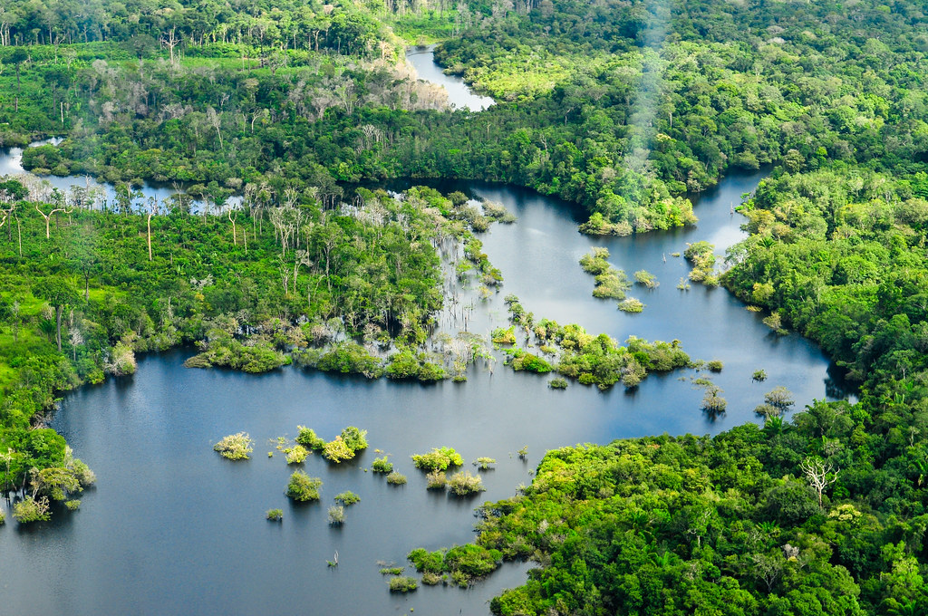
‘Elm' Homework – W/C 2nd September 2024
Science: Digestion: Make a model of the human digestive system using junk modelling materials. | English: Reading Research the author, Lynne Cherry. What has she done to help the rainforest? How many books has she written? | Geography: Rainforests – Can you find information on the locations of rainforests around the world. You could plot this on a world map. | History: Rainforests – Research a famous rainforest explorer, choose from: Francisco de Orellana, Francisco Pizarro, Alexander Van Humboldt, Henry Walter Bates or Teddy Roosevelt.
Art: Henri Rousseau: Have a look at the rainforest paintings Henri Rousseau created and make a piece of artwork inspired by his work. This could be drawn or painted. | ‘Reach for the Stars’ Homework challenges! Over the term, we would like you choose a different challenge each fortnight. There are lots to choose from – over the term you only need to complete SIX! Hand-in dates: 13th September 27th September 11th October 25th October 15th November 29th November 13th December |  | Art and Design: Rainforests: Can you create a picture of a Rainforest? It could be drawn, painted or even crafted and can be 2 dimensional or 3 dimensional.
English: Writing Write a description of a rainforest. How would you feel when exploring it? What would you see, hear, smell and taste? | Writing: Research and create a fact file on an endangered animal, include details about habitat, diet and numbers left in the wild | Computing: Create a PowerPoint about the rainforest using facts found on the internet. | Save the Rainforest! An area the size of a football pitch is being destroyed every second! Create a poster or leaflet to persuade people to help protect the rainforest.

